Slide 1
Welcome
Girish Jois

Slide 2
SGB CLIENT VISIT
(Saturday, 23rd Dec 2023)

Slide 3
Agenda
S.No | Date / Day | Session | Topic | Time | Speakers | Participants | Location
1 | 23 Dec 2023 / Saturday |  | Arrival to Mayavaram by Train | 12:30 PM |  | Girish Jois | Mayavaram
2 |  |  | Pickup from Mayavaram, Check-In Hotel TQB and Lunch at Hotel | 1:30 PM to 2:30 PM | Ramesh & Saravanan | Girish Jois | TQB
3 |  |  | Pick up from Hotel, TQB to LMNAs TQB by CAB | 2:30 PM to 3:00 PM | Ramesh & Saravanan |  | TQB
4 |  | Session 1 | Welcome at LMNAS, Arrival Welcome, lighting | 3:00 PM to 3:15 PM | Jothi & Girish | Girish Jois & Jothi | LMNAS, TQB
5 |  | Session 2 | Introduction & Overview - SGB & LMNAS | 3:15 PM to 3:45 PM |  | Girish Jois & Arun G | LMNAS, TQB
6 |  | Session 3 | OCC Monitoring for Support | 3:45 PM to 4:15 PM | Ramesh ,Fathima & Arul | Ramesh / Fathima | LMNAS, TQB
7 |  | Session 4 | Process Mining Solution Demo | 4:15 PM to 4:45 PM | Ayesha | Ayesha | LMNAS, TQB
8 |  |  | Coffee Break | 4:45 PM to 5:15 PM |  | Jothi | LMNAS, TQB
9 |  |  | Discussion on next steps with SGB | 5:15 PM to 6:00PM | Girish
10 |  | Session 5 | LENS CRM Demo | 5:15 PM - 5:45 PM | Marliya & Arun | Arun G | LMNAS, TQB
11 |  |  | Dinner | 7:00 PM |  |  | Karaikal
12
13 |  |  | Drop to Hotel, TQB | 9:00 PM
14 | 24 Dec 2023 / Sunday |  | Sight Seeing visit (Thirukadaiyur Temple, Thirumaiyam) | 9:00 AM

Slide 4
Day in a Life scenario
Client LENS SaaS Landscape
Internet Connectivity
Service Enablers
Smart Operations Layer L1.5
Service Operations
OCC Monitoring
24x7 IRT Support I Incident & Service triage & route (Catch/Dispatch) I Health Checkups/Housekeeping jobs
Rapid Response
Incidents
Service Requests
Enhancements
LENS Service Management
Shared Services Team
Service Integration
Core Team
Flex Team(On demand)
Reserved Capacity for customers
FACTORY (Common across customer)
Python
Java Script
PHP / HTML
User provisioning
Security & Authorization
L3, Projects
Integration
Developers
Analytics
Capacity Planning
Data Migration
Other skills (On requests)
Process Command Centre
Finance
Sales
Buying
Production
Inventory
Innovation Practice
Temporary workaround I Break-fix(data) I Maintenance I Operations I Service requests I Escalated Incidents I Break-fix I Problem management I Minor enhancements
Major Enhancement I Projects
Delivery Assurance
Governance and Risk
C SAT
Delivery Enables
Talent Transformation

Slide 5
OCC Monitoring Demo

Slide 6
LENS ERP Product Release Roadmap
Year - 2024
Year - 2025
M1
M3
M5
M7
M9
M11
M1
M3
Assessment
Assessment
Assessment
Assessment
Assessment
Assessment
LENS ERP Release 14 Assessment & Upgrade
v14.40.0
v14.44.0
LENS ERP Release 14
Patch upgrade
Patch upgrade
v14.46.0
Patch upgrade
v14.47.0
Patch upgrade
v14.51.0
Patch upgrade
v14.53.0
Patch upgrade
Assessment
Assessment
v15.0.0
Release 15 Assessment & Upgrade
LENS ERP Release 15
New Release Version Checkpoint
v15.1.0
Version upgrade
v15.5.0
Patch upgrade

Slide 7
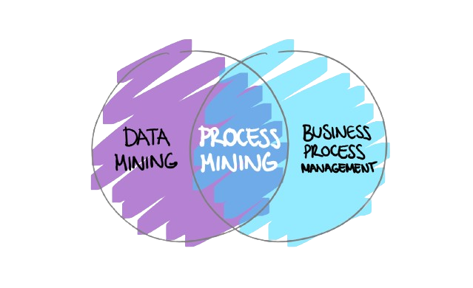
LENS Business Hyper Vision (LENS BHV)
LMNAs Independent Journey in Process Mining

Slide 8
Our Objectives
Discover current processes and identify gaps in execution.
Accurately identify the root causes and factors triggering, process gaps & deviations, order’s friction & reworks.
Streamline process execution through process Standardisation and Harmonization.
Document current processes at various levels along with the existing variations & outliers (through process flow diagrams) .
Improve visiblity of the process: Performance, Bottlenecks & KPIs, areas causing friction.

Slide 9
Benefits
Review and analyse main flows and process deviations within OTC.
Refine & redesign order fulfilment process and systems where more transactions can be processed with less touches at lower cost.
Have a standardized / harmonized process followed within the company with minimal process gaps.
Highlight uncover/hidden friction through user activities/behaviors that are otherwise not visible with current reporting capabilities .
Properly trace the number of unnecessary touch points / changes / reworks / bottle necks within order fulfilment process.

Slide 10


Roadmap
Identifying Bottleneck and Inefficiencies
Utilizing AI and Automation
Implement advanced analytics to pinpoint areas for improvement.
Optimize processes to enhance overall efficiency.
Integrate AI algorithms for predictive analysis.
Implement automation solutions to streamline workflows and reduce manual intervention.

Slide 11
LENS BHV Demo

Slide 12
LENS CRM Demo

Slide 13
Thank You

